Slide 1

Bridging the GAP
NEEDS
GAP
SOLUTION
Wellness:
To be and look healthy
To manage overweight and obesity
To maintain beauty
To maintain a healthy life
Skills Development:
To have skilled workforce
To provide professional services
Strategy
Structure
Credible Solutions
Skills
Results
Providers
Guidance
Staff
VLCC
Skills
Style
Systems
INVESTOR OPPORTUNITY
BRIDGE
CREATE REVENUE

Slide 2







FOFO Model – Franchise Owned, Franchise Operated
Countries where VLCC is not present yet
FRANCHISEE
VLCC
BUILD UP CAPITAL
VLCC
WELLNESS CENTER
OVERALL SUPPORT
Build the center
Buy equipment
Set up the business
Layout Designing
Equipment & product Support
WORKING CAPITAL
Manage the center
VLCC Institute
Training
Pay month
operational Expenses
Responsible for
profit or Loss
Marketing guidance
Recruitment Support

Slide 3
JVP Model – Joint Venture Partnership
Countries where VLCC has existing operations
PARTNER
VLCC
VLCC
WELLNESS CENTER
BUILD UP CAPITAL
WORKING CAPITAL
Build the center
Buy equipment
Set up the business
Manage the center
%
on Sales
%
on Profits*
VLCC Institute
Pay month
operational Expenses
Pay only Initial buildup Capital
Receive monthly Returns
*You don’t pay for Loss, if any!

Slide 4

Business Model Matrix – WELLNESS CENTER
FOFO
JVP
300 +
Area Required Sq.Mtr
450 +
USD. 300,000 to 900,000
Initial Investment**
AED>2.3 Million +
28% -34%
Rate of Return
28% - 34%
28 – 36
Payback Period* (month)
28 –36
Applicable
Signup Fees
Applicable
12.5 %
VLCC Royalty (monthly)
NA
Profit/Loss of center
Partner’s Returns (monthly)
3 % of Sales & 30 % of profits
Multi Unit & Country Master Franchisee Options are available
* Payback period may change depending on center location/area/months
** Investment includes signup fees, initial visa & HR costs, fit-outs, equipment, licensing and center branding

Slide 5
Business Model Matrix – INSTITUTE
FOFO
JVP
250 +
Area Required Sq.Mtr
350 +
100,000 to 300,000
Initial Investment** (USD)
100,000 +
28% -34%
Rate of Return
28% - 34%
28 – 36
Payback Period* (month)
28 – 36
Applicable
Signup Fees
Applicable
12.5 %
VLCC Royalty (monthly)
NA
Profit/Loss of center
Partner’s Returns (monthly)
3 % of Sales & 30 % of profits
Multi Unit & Country Master Franchisee Options are available
* Payback period may change depending on center location/area/months
** Investment includes signup fees, initial visa & HR costs, fit-outs, equipment, licensing and center branding

Slide 6

Way Forward

Slide 7
Steps to Success - FOFO
1
2
3
4
5
Interest
Pre-Sign Up
Finalization
Development
Opening
Process :
Submit Application
Meet & Visit VLCC
Analyze business Options
Evaluate Financial Model
Process :
Review LOI
Sign & Pay LOI fees
Review Final Agreement
Process :
Sign & Pay Franchise fees
Identify Location
Approve location - VLCC
Finalize Location
Process :
Project Execution Plan
Execute Fit Out works
Obtain Licenses
Order & receive Equipment
Order & receive Products
Hire & Train Staffs
Process :
Treatment list
Price Fixation
Marketing Plans
Soft Launch
Grand Launch
Timeframe :
2 Weeks
Timeframe :
2 Weeks
Timeframe :
2 Weeks
Timeframe :
14 Weeks
Timeframe :
4 Weeks
Deliverables :
Assess business opportunity
Deliverables :
Decide to sign up
Deliverables :
Confirmed to Invest
Deliverables :
Build the Center
Deliverables :
Begin Operations
Guided & Supported by VLCC at all Stages – Managed & Operated by Franchisee

Slide 8
Steps to Success - JVP
1
2
3
4
5
Interest
Pre-Sign Up
Finalization
Development
Opening
Process :
Submit Application
Meet & Visit VLCC
Analyze business Options
Evaluate Financial Model
Process :
Review LOI
Sign & Pay LOI fees
Review Final Agreement
Process :
Sign & Pay Sign-up fees
Identify Location
Finalize Location
Process :
Project Execution Plan
Execute Fit Out works
Obtain Licenses
Order & receive Equipment
Order & receive Products
Hire & Train Staffs
Process :
Treatment list
Price Fixation
Marketing Plans
Soft Launch
Grand Launch
Timeframe :
2 Weeks
Timeframe :
2 Weeks
Timeframe :
2 Weeks
Timeframe :
14 Weeks
Timeframe :
4 Weeks
Deliverables :
Assess business opportunity
Deliverables :
Decide to sign up
Deliverables :
Confirmed to Invest Capital
Deliverables :
Build the Center
Deliverables :
Begin Operations
6
Process :
VLCC will Operate, manager &
Pay center expenses
Timeframe :
5 Years
Deliverables :
Partner Receives Monthly Returns
Handover to VLCC

Slide 9
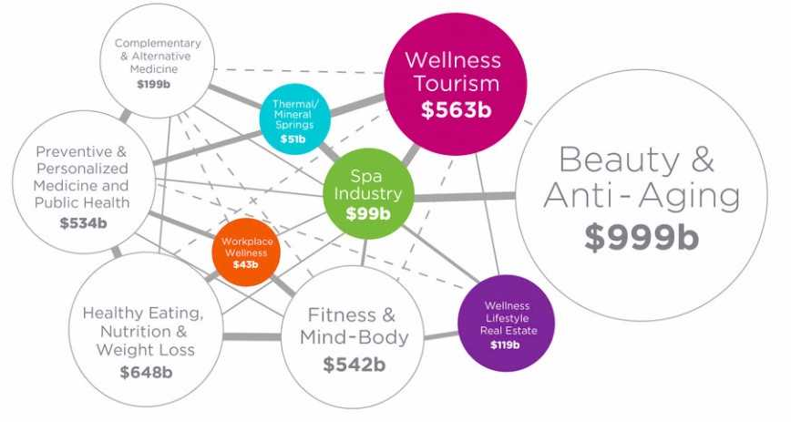

Conclusion – Know this is right
A WORLD OF
ENDLESS GROWTH AWAITS

Slide 10

Transforming Lives
www.vlccwellness.com

